Slide 1
COST Projeleri
Uluslararası İşbirliği
Prof. Dr. Mustafa ERSOZ
COST Bilimsel Komitesi, Başkan Yrd
Selcuk Üniversitesi, Kimya Böl.
mersoz@selcuk.edu.tr

Slide 2
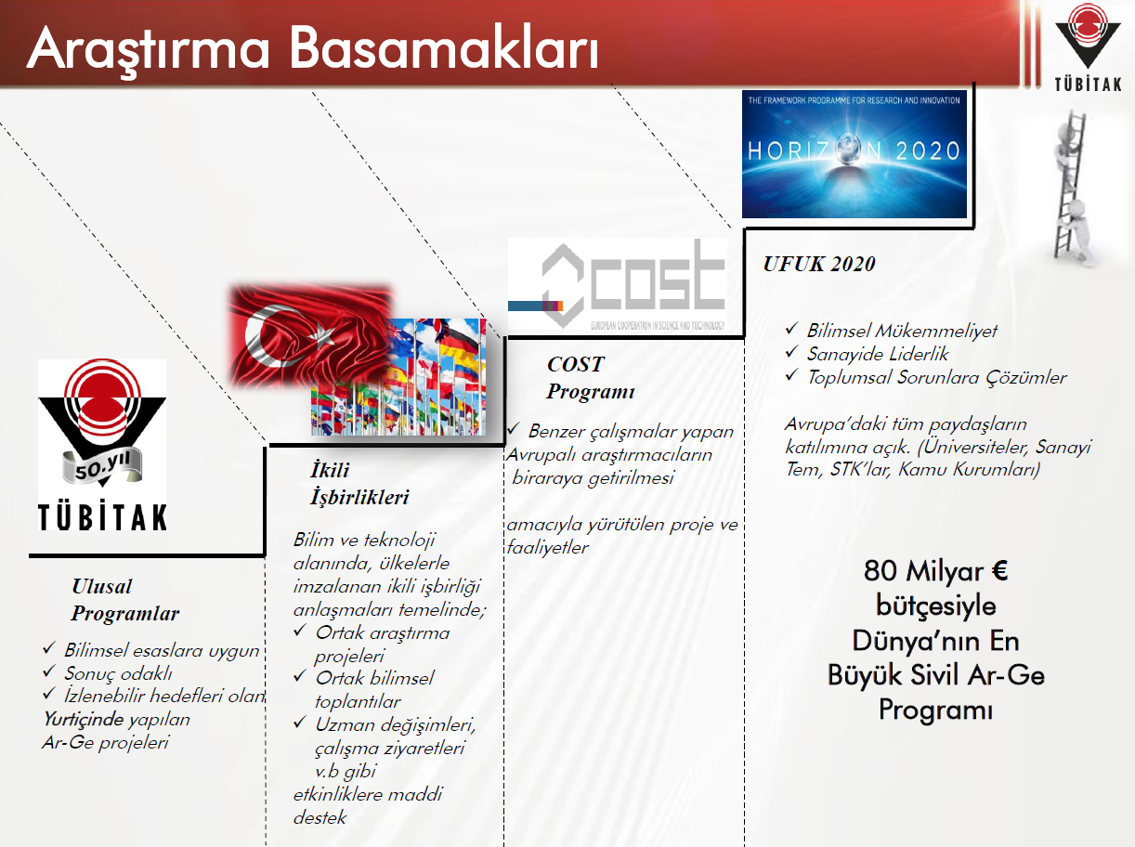

Slide 4
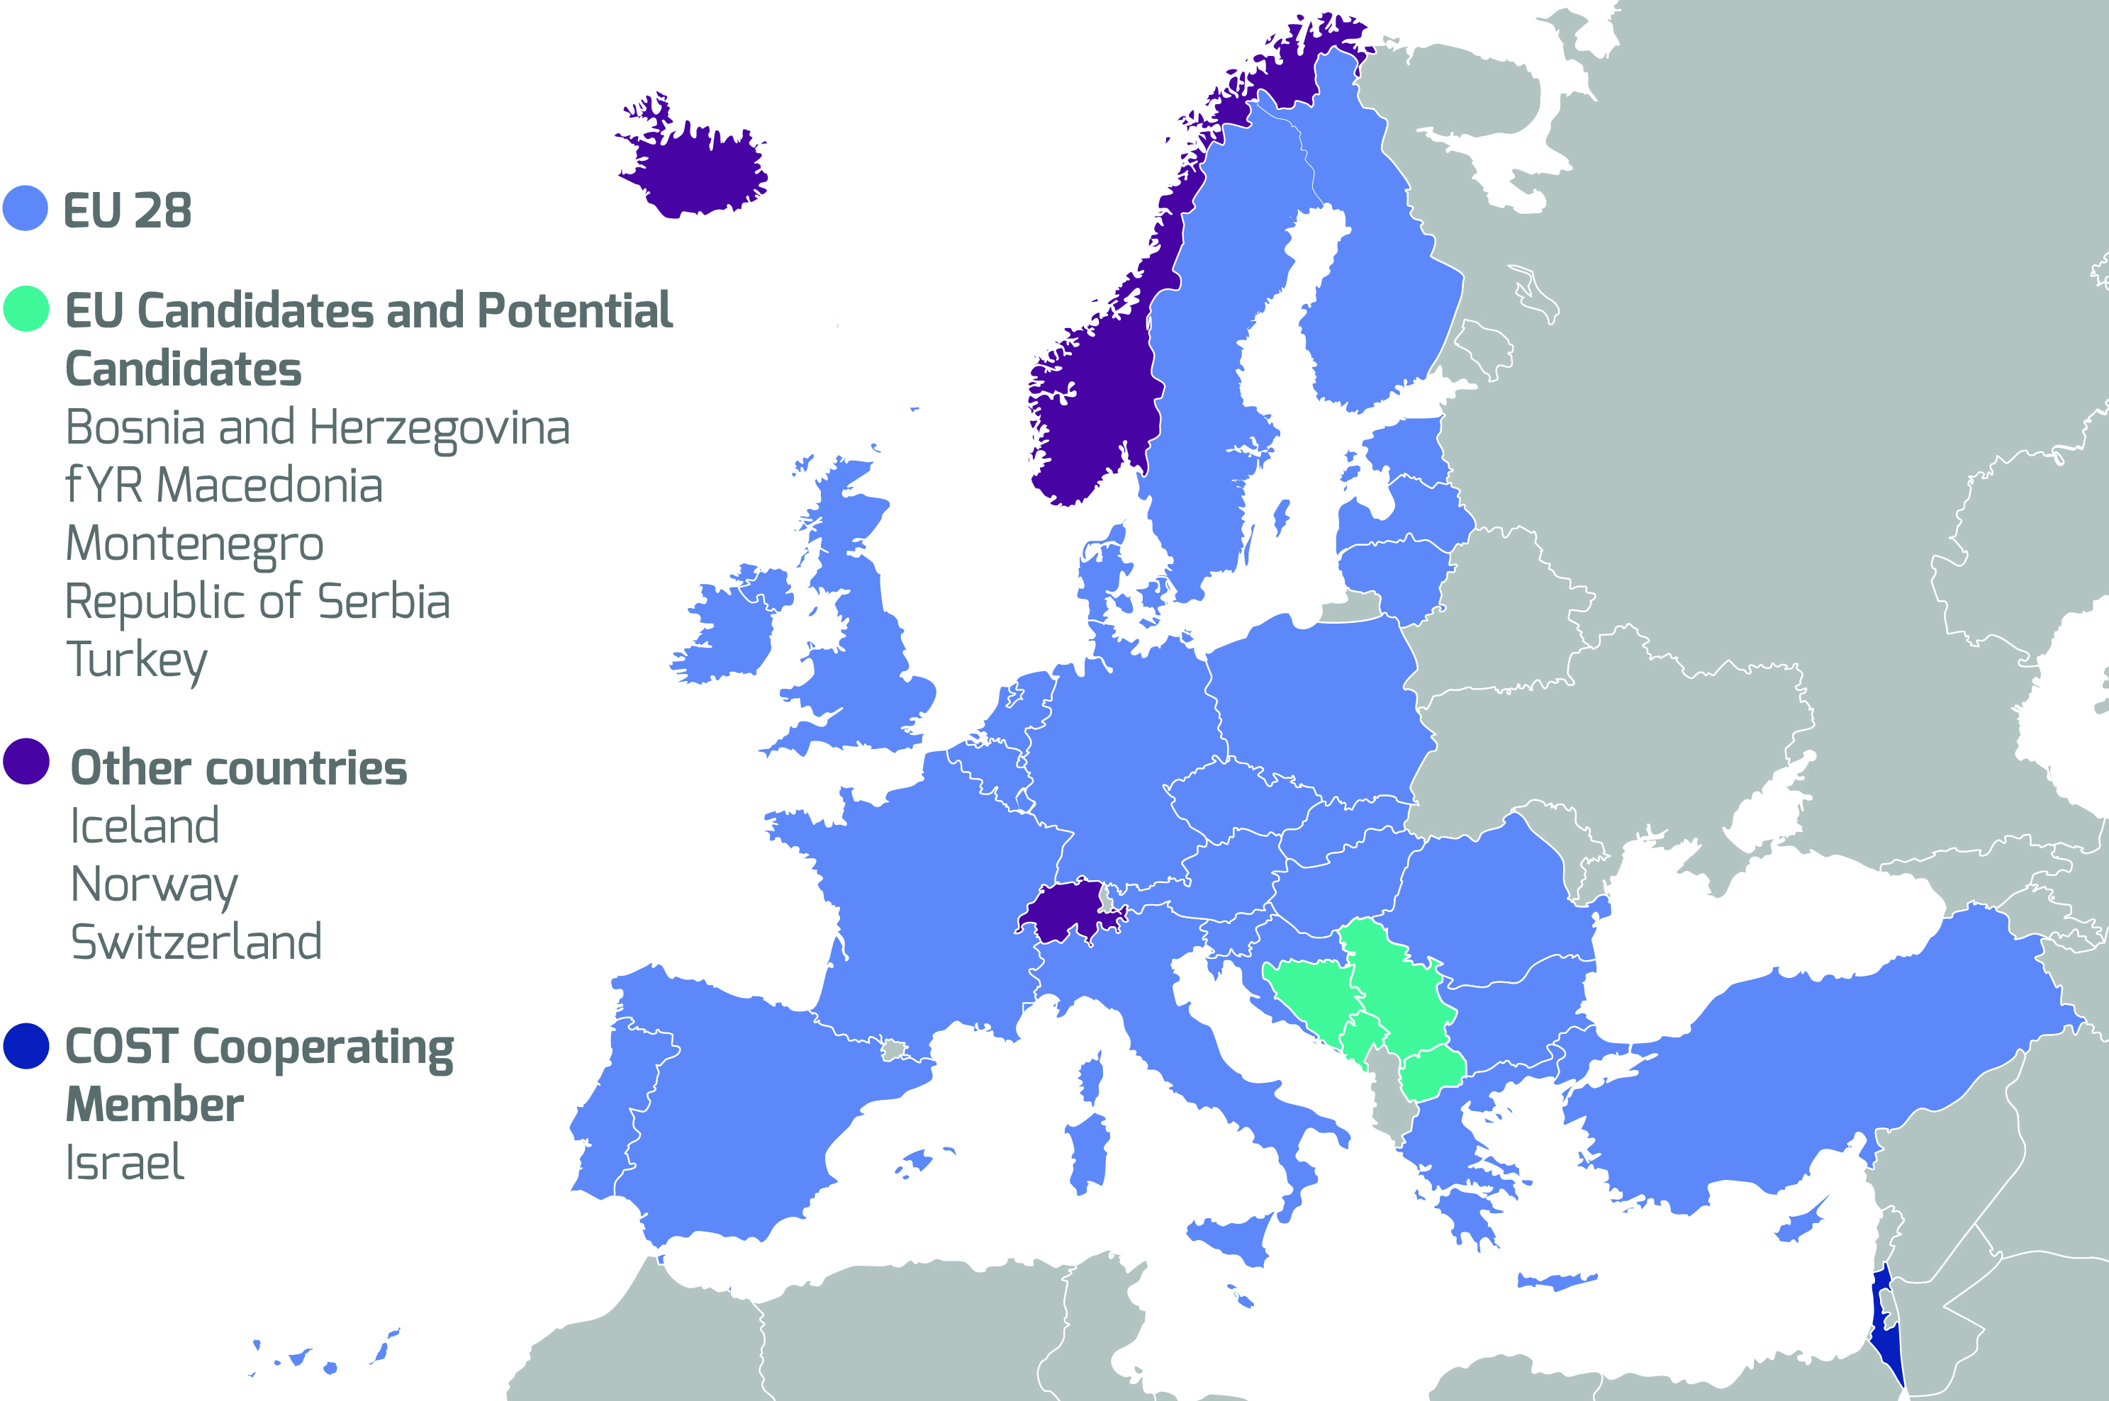
37 COST members

Slide 5
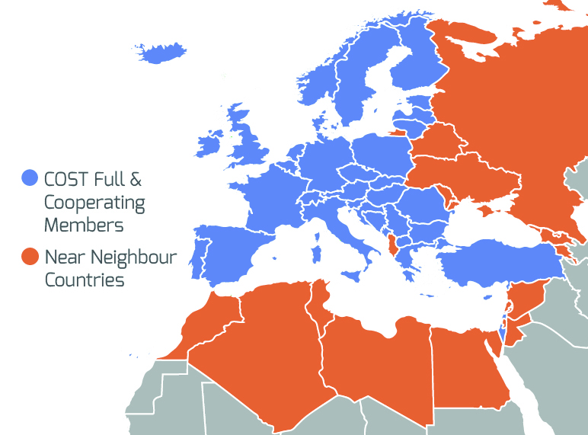
Near Neighbour Countries
Notes:
Example of Action

Slide 6
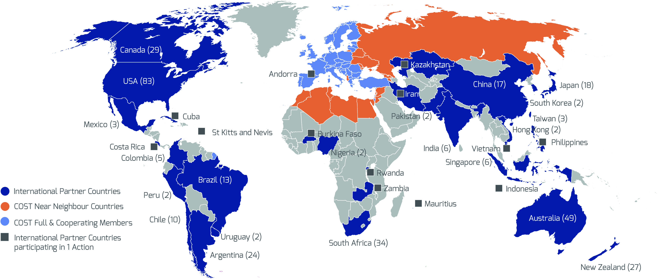
International Partner Countries

Slide 7






3 level scientific classification
6 Main Fields of Science:
Natural Sciences,
Engineering and Technology,
Medical and Health Sciences,
Agricultural Sciences,
Social Sciences,
Humanities
  41 Sub-fields of Science…
    719 areas of expertise (research areas)
Ex. a research project need to share knowledge in order to create a common understanding of problems at hand, and to coordinate activities
New knowledge (innovations) seem often to arise from synthesis and re-combination of spread pieces of knowledge (disruptive innovation
Create synergies where 1+1 is more than 2
Notes:
Knowledge sharing leads to..
Participants in, for example, a research project need to share knowledge in order to create a common understanding of problems at hand,
and to coordinate activities. This applies to information seeking, interpretation, analyses etc including timing and sequencing of research tasks and reporting.
New knowledge (innovations) seem often to arise from synthesis and re-combination of spread pieces of knowledge (disruptive innovation). These are pieces already existing here and there, and which may serve quite new functions when put together in new and innovative ways. There is a common understanding that networking creates synergies, where 1+1 is more than 2.

Slide 9




























How it works
COST Action participants
nominated by COST National Coordinators
Main proposer
Secondary proposers

Slide 11
Notes:
Knowledge sharing leads to..
Participants in, for example, a research project need to share knowledge in order to create a common understanding of problems at hand,
and to coordinate activities. This applies to information seeking, interpretation, analyses etc including timing and sequencing of research tasks and reporting.
New knowledge (innovations) seem often to arise from synthesis and re-combination of spread pieces of knowledge (disruptive innovation). These are pieces already existing here and there, and which may serve quite new functions when put together in new and innovative ways. There is a common understanding that networking creates synergies, where 1+1 is more than 2.

Slide 12
Notes:
Knowledge sharing leads to..
Participants in, for example, a research project need to share knowledge in order to create a common understanding of problems at hand,
and to coordinate activities. This applies to information seeking, interpretation, analyses etc including timing and sequencing of research tasks and reporting.
New knowledge (innovations) seem often to arise from synthesis and re-combination of spread pieces of knowledge (disruptive innovation). These are pieces already existing here and there, and which may serve quite new functions when put together in new and innovative ways. There is a common understanding that networking creates synergies, where 1+1 is more than 2.

Slide 16
COST aksiyonlarına katılım

Slide 17


Core policies
Excellence and inclusiveness (widening the European research base)
  Strengthening the excellence through cross-border networking of researchers
  Promoting geographical, age and gender balance throughout its activities and operations
  Specific objectives
  International cooperation (mutual benefit, NNC,…)
  Industrial dimension (dedicated dissemination and exploitation activities)
  Geographic pillar (support to less research intensive countries, connecting pockets of excellence,…)
  Career pillar (support to young researchers: leading roles, access to STSM/TS)
  Gender pillar (Gender balance)
Notes:
Geographic pillar (support to less research intensive countries, connecting pockets of excellence,…)
Career pillar (support to young researchers: leading roles, access to STSM/TS)
Gender pillar (Gender balance)

Slide 18
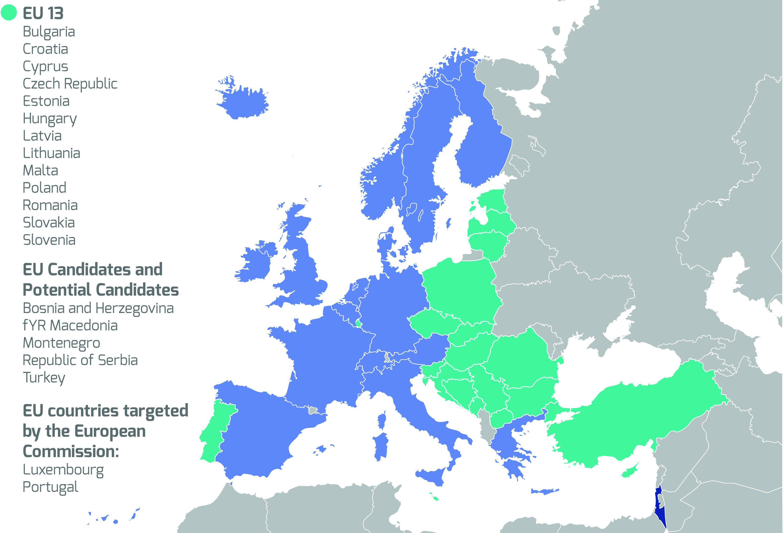
COST Inclusiveness Target Countries

Slide 19
Task force measures to increase spending for researchers from ITC
  Require COST Action proposals to have a minimum of 7 countries represented in the proposal, as well as a minimum of ITCs amongst represented countries in the proposal, according to a lookup table (min; 3/4 3= ITC)
  Reserve at least 1 of the key Action position available for participants from ITCs
  Introduce a conference grant for PhD students and Early Career Investigators
  Examine the possibility for a mentoring scheme targeting young ITC researchers

Slide 20
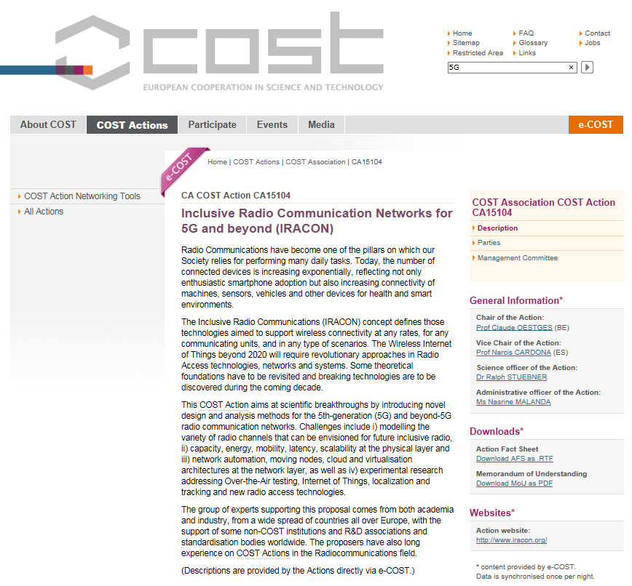
Search an Action/contact

Slide 21
Join an Action
Search existing Actions in your topic from the COST website
Browse the Action’s own website – check their activities
Find if your country participates and, if yes, who is/are the national representatives
Contact the relevant person
You can join/establish consortium to prepare, submit the proposol for Open Call
Turkish Researchers
If you have project, 1001, 1003, 3501 etc. in the same area, Contact to TUBITAK-UIDB for converting to your project to COST and appoinment to COST Office
Or,
Prepare a new proposal under TUBITAK-2515 format
Contribution one of WPs in MoU

Slide 22
Mevcut aksiyonlara katılım

Slide 25
Destek mektubu ile katılım
Motivation letter, Contribution, CVs

Slide 26
Role of COST in the ERA – 3 Strategic Priorities
Promoting and spreading excellence
Fostering interdisciplinary research for breakthrough science
Boosting careers young researchers
1
2
3
Notes:
Knowledge sharing leads to..
Participants in, for example, a research project need to share knowledge in order to create a common understanding of problems at hand,
and to coordinate activities. This applies to information seeking, interpretation, analyses etc including timing and sequencing of research tasks and reporting.
New knowledge (innovations) seem often to arise from synthesis and re-combination of spread pieces of knowledge (disruptive innovation). These are pieces already existing here and there, and which may serve quite new functions when put together in new and innovative ways. There is a common understanding that networking creates synergies, where 1+1 is more than 2.

Slide 27
COST as H2020 pre-portal
Priority 2. Fostering interdisciplinary research for breakthrough science
Horizon 2020 applications reported by finished COST Action
Total Actions with finished Final Action report | Submitted H2020 proposals reported | Approved H2020 projects reported | Success rate
62 | 230 | 65 | 28%

Slide 28






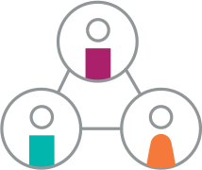

Positioning COST in the ERA - H2020 and beyond
COST Academy
COST Actions
COST Innovators Grant
COST science-informed policy advice
Meetings, workshops
and conferences, and conference grant
Training schools
Short-term Scientific
Missions
Dissemination
activities
COST global networking
COST Connect
Notes:
Through the COST Action, COST funds conferences, workshops, short-term scientific missions, training schools, publications and other communication tools to link the participants together for four years. By funding these networking activities, COST has contributed to profound changes in science and technology.
By strengthen this core business, COST will remain the most efficient and user-friendly research networking tool for research and be the leading community for science exchange in the ERA. In order to stay relevant and to respond to the new needs and challenges ahead, COST Actions will exploit virtual environments and digital opportunities, providing even more efficient collaborative tools. Virtual and digital networking tools will not only maximize the budget of the Action, but will also allow the participation of more researchers in each COST Action.
Flexibility and adaptability will be characteristics that will be introduced in the next generation of COST Actions, namely by allowing variations in size and duration. This particular aspect will serve both the modernization of the networking systems and the lowering of the entrance barriers for the isolated niches of excellence.
Besides strengthening its core business through enhanced and modernized COST Actions, COST will add value to its core businesses, by offering new services that strengthen its position and that of its Actions in the ERA. COST will establish partnerships with other research and innovation stakeholders creating a unique network and offer a wide range of opportunities for researchers across Europe, making COST an indispensable partner in the European R&D community.
COST Connect
With the COST Connect workshops, COST offers a forum to COST Actions and other ERA stakeholders in a specific research or innovation domain. The aim is to create synergies between stakeholders working on a similar topic, to provide networking and funding opportunities, to link researchers with policy makers and thus connect the dots in the European Research Area.
COST Academy
The COST Academy enhances the financial, leadership and communication skills of ITC and younger or less experienced researchers with respect to COST Action management, . The COST Academy will offer a series of specific workshops as well as various modules of online training courses to groups in need of additional training and mentoring.
COST ERA Funding Portal
COST will act as a pre-portal to other ERA funding instruments, making COST the ‘glue’ in the ERA. Participation and collaboration with ERA stakeholders will occur within the frame of COST activities and at a higher-level, with systematic linkages established with key stakeholders. These include the European Commission (DG R&I, DG Connect), JRC, ERC, EIT, JPI’s, etc.
COST Info Days
Targeted InfoDays will be organised in COST Inclusiveness Target Countries and COST Near Neighbour Countries. InfoDays are a useful tool to address the research community and inform them about the networking possibilities COST is offering. These InfoDays have the aim to increase participation from both ITC and NNC within COST activities.
COST Science-informed policy advise
By providing researchers and experts with the tools to meet, to network and to brainstorm, COST is in an ideal position to provide science-informed policy advice to policy makers. During the lifetime of an Action, COST encourages and supports their participants to disseminate the outcome of their research to other COST science and technology networks, the wider scientific community, policymakers, the media and society at large. COST will supports its activities by funding a series of visibility opportunities and dissemination/publication activities, and engages on an active level with policy makers and decision takers.
COST Global Networking
The open and bottom-up nature of the COST Action allows researchers to establish the most complete and complementary team of co-workers. The scientific expertise that is required to reach the full potential within a COST Action might not always be present in Europe. Therefore, COST has a pro-active Open to the World policy, where researchers from all over the world can join the COST activities, and by this contributing to its overall objectives.
COST Proof of Concept
For COST Actions that demonstrate a commercial/innovation component, an additional budget could be issued to increase the potential take up. The funding could cover activities of turning the research network outputs into a commercial proposition (participation of certain number of SMEs in the COST Action, clarify intellectual property rights position and strategy, provide feedback for budgeting and other forms of commercial discussion, provide connections to later stage of funding, cover initial expenses for establishing a company, etc).

Slide 29
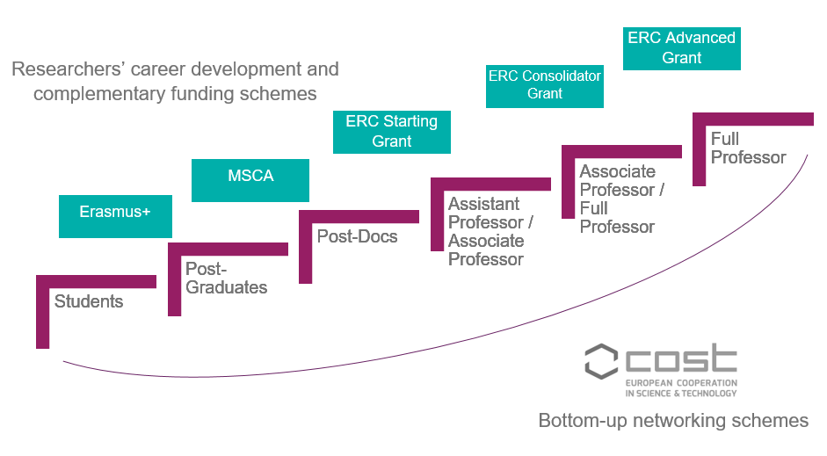
Boosting careers of young researchers

Slide 31

COST Connect objectives: increased visibility and impact
COST Connect
COST Action representatives
ERA stakeholders
Exploit synergies, avoid duplication, exchange information
Align activities, jointly address strategic research and innovation agendas
Access to future calls, scaling up of activities
Exploit capacity building opportunities
Connecting the dots in the ERA

Slide 32
Executed and planned events
COST Connect topic | Date | Location | Status
1: Water for Agriculture and Food in the Mediterranean (Pilot) | 28/06/2017 | Brussels | Done
2: Next Generation Internet | 12-13/09/2017 | Brussels | Done
3: Cultural Heritage in the Digital Era | 25/10/2017 | Brussels | Done
4: Relevance of impact in R&I policies: Role of Networking | 24/11/2017 | Brussels | Plan
5: Quantum Science and Technology | 08/03/2017 | Warsaw | Plan
Urbanisation/Urban Cities (tbd) | tbd | tbd | Idea
Social Inclusion (tbd) | tbd | tbd | Idea
Danube Region (tbd) | tbd | ITC | Idea
Climate Change and Forestry | 05/06/2017 | Sofia | Plan
… further scheduling ongoing / health, ICT, energy, … |  |  | Ideas

Slide 33
Revision of the evaluation questions
S&T EXCELLENCE | NETWORKING EXCELLENCE | IMPACT | IMPLEMENTATION
Total marks for the section = 15 points | Total marks for the section = 15 points | Total marks for the section = 15 points | Total marks for the section = 5 points
TOTAL MARKS AWARDED = 0 - 50 points OVERALL THRESHOLD = 34 points

Slide 34
7. Evaluation
Revision of the RP role
  Future
iEE IER
iEE CER with RP Member involved
CER Final
SC mtg
iEE IER
RP mtgs
iEE IER
Implementation:
18-1 “involved” = observes and provides input
18-2 “involved” = observes, provides input and votes to approve

Slide 35
EC Joint Research Center,
Nanobiyoteknoloji Laboratuarı Eğitim ve Kapasite Geliştirme Çağrısı Açtı!
Training and Capacity Building topics for the Nanobiotechnology laboratory (Ispra, Italy
Nanobiotechnology laboratory
Mode: Training and Capacity Building
Identifier: 2019-1-TCB-NanoBiotech
Location: Ispra, Italy
Opening of the call: 04/03/2019
Closure of the call: 03/06/2019
Communication of the assessment of proposals: : 28/06/2019
Notes:
Knowledge sharing leads to..
Participants in, for example, a research project need to share knowledge in order to create a common understanding of problems at hand,
and to coordinate activities. This applies to information seeking, interpretation, analyses etc including timing and sequencing of research tasks and reporting.
New knowledge (innovations) seem often to arise from synthesis and re-combination of spread pieces of knowledge (disruptive innovation). These are pieces already existing here and there, and which may serve quite new functions when put together in new and innovative ways. There is a common understanding that networking creates synergies, where 1+1 is more than 2.

Slide 36
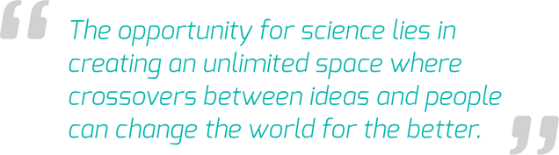
Contact and engage with us
Sign up to our news: www.cost.eu/subscribe
Join us on our social networks:
www.facebook.com/COST.Programme/
https://www.linkedin.com/company-beta/1050548/
@COSTprogramme
https://www.youtube.com/user/COSTOffice

Slide 37


Bilim ve Teknoloji
Araştırma ve uygulama merkezi
(bitam)
www.erbakan.edu.tr/bitam

Slide 38

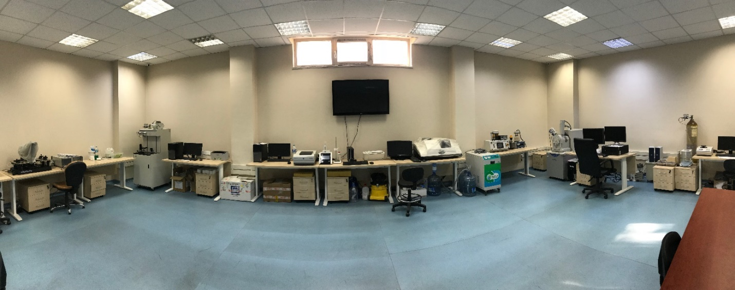
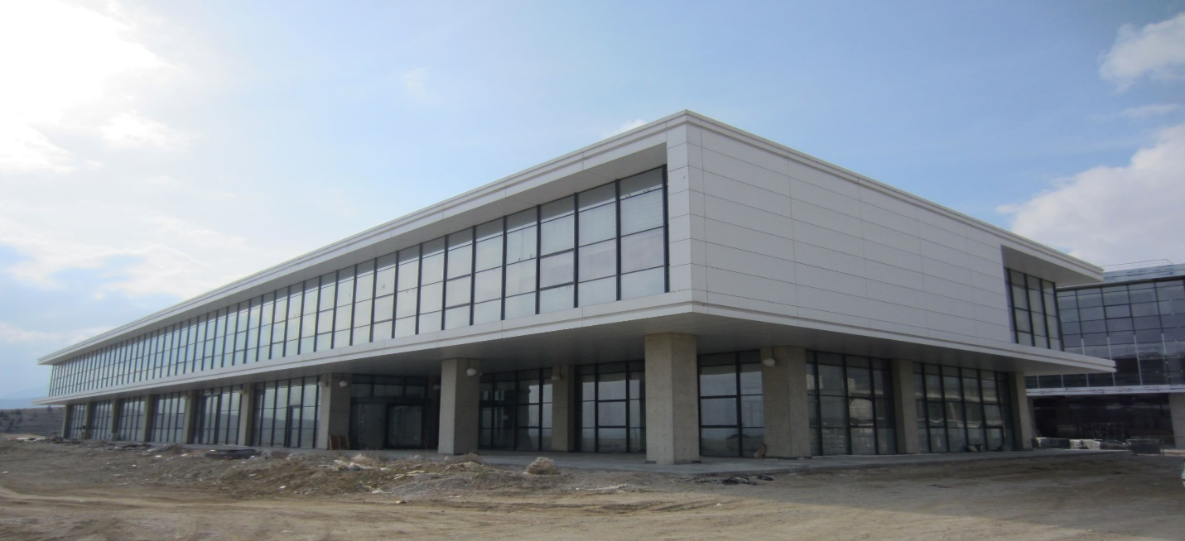
BİTAM
www.erbakan.edu.tr/bitam
AKEF Birimi
AKEF B1 Blok Bodrum Kat
Aktif
Bürüt 300 m²
Cihaz Odaları/Temiz Alan
KÖYCEĞİZ Binası
Sosyal ve Beşeri Bilimler Fakültesi Karşısı
Yapım Aşamasında
Bürüt 5.000 m²

Slide 39
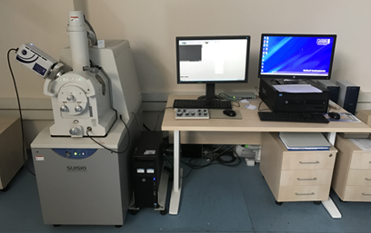
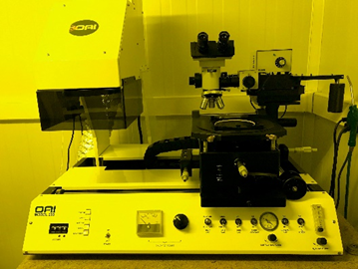
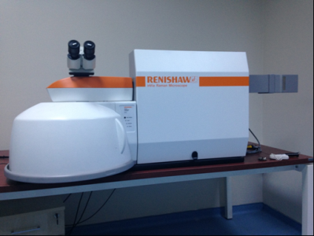
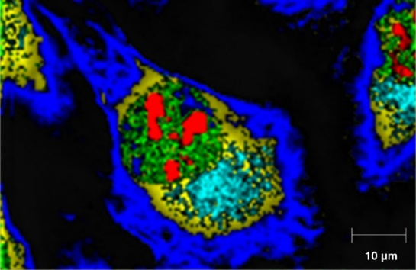
BİTAM
www.erbakan.edu.tr/bitam
Cihaz ve Analiz Hizmeti (AKEF BİRİMİ-AKTİF)
AFM (Atomik Kuvvet Mikroskobu)
BET (Yüzey Alanı - Gözenek Boyutu Cihazı)
Civalı Porozimetre
Empedans Analizörü
FTIR (Fourier Dönüşümlü Kızıl Ötesi Spektrometresi)
GC-MS (Gaz Kromatografisi - Kütle Spektrometresi)
Helyum Piknometresi
İnce Film Kaplama Sistemleri (Termal Buharlaştırma)
Konfokal Raman
Litografi
Nanopartikül Boyutu - Zeta Potansiyel
www.erbakan.edu.tr/bitam

Slide 40
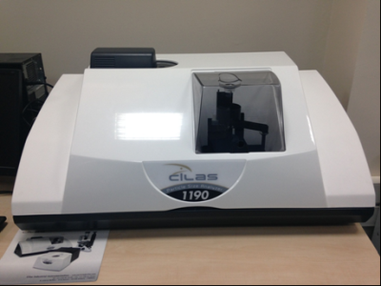
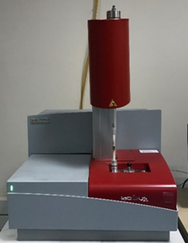
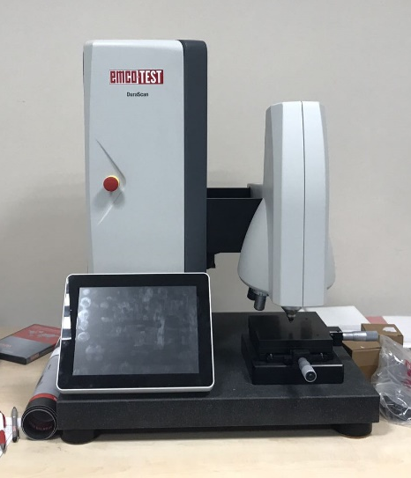
BİTAM
www.erbakan.edu.tr/bitam
Cihaz ve Analiz Hizmeti (AKEF BİRİMİ-AKTİF)
Partikül Boyutu
Plazma Temizleme
Prob İstasyonu
SEM (Taramalı Elektron Mikroskobu)
Sertlik Ölçüm Cihazları (Brinell-Rockwell-Vickers)
Spektroflorometre
TEM (Geçirimli Elektron Mikroskobu)
Temas Açısı ve Yüzey Gerilimi
TGA / DSC (Termal Analiz)
UV - Vis Spektrofotometresi
XRD (X-Işınları Difraktometresi) (GNR)
XRF (X-Işınları Floresans Spektrometresi)

Slide 41
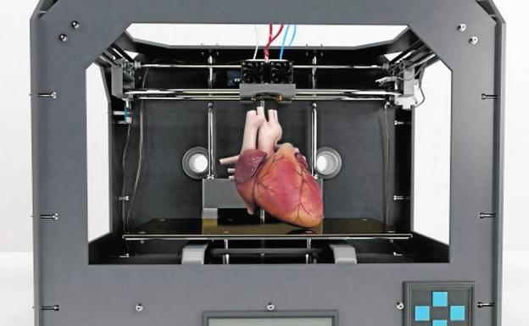
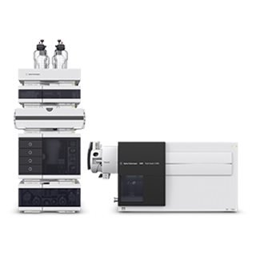
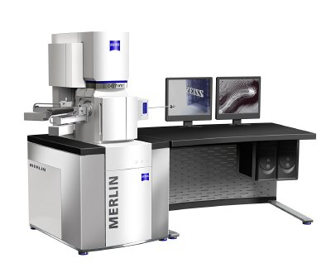
BİTAM
www.erbakan.edu.tr/bitam
Cihaz ve Analiz Hizmeti (KÖYCEĞİZ BİNASI-KURULUM)
3D Tarayıcı/Yazıcı
ICP-MS
LC-MS/MS
GC Head Space / Termal Desorber
GC-MS/MS
Yorulma Cihazı
XRD (X-Işınları Difraktometresi)
FE-SEM (Taramalı Elektron Mikroskobu

Slide 42

BİTAM
www.erbakan.edu.tr/bitam
Bilimsel Faaliyetler (KÖYCEĞİZ BİNASI)
TEMA
Biyomalzemeler ve Biyoteknoloji
Dental Araştırmalar
Enerji ve Yarı İletken Teknolojileri
Gıda ve İlaç
Hücre Biyolojisi ve Genetik
Malzeme ve Üretim Teknolojileri
Sinir Bilimleri
Bilim, Teknoloji ve Toplum

Slide 44
Notes:
Knowledge sharing leads to..
Participants in, for example, a research project need to share knowledge in order to create a common understanding of problems at hand,
and to coordinate activities. This applies to information seeking, interpretation, analyses etc including timing and sequencing of research tasks and reporting.
New knowledge (innovations) seem often to arise from synthesis and re-combination of spread pieces of knowledge (disruptive innovation). These are pieces already existing here and there, and which may serve quite new functions when put together in new and innovative ways. There is a common understanding that networking creates synergies, where 1+1 is more than 2.

Slide 45
Notes:
Knowledge sharing leads to..
Participants in, for example, a research project need to share knowledge in order to create a common understanding of problems at hand,
and to coordinate activities. This applies to information seeking, interpretation, analyses etc including timing and sequencing of research tasks and reporting.
New knowledge (innovations) seem often to arise from synthesis and re-combination of spread pieces of knowledge (disruptive innovation). These are pieces already existing here and there, and which may serve quite new functions when put together in new and innovative ways. There is a common understanding that networking creates synergies, where 1+1 is more than 2.

Slide 46
Notes:
Knowledge sharing leads to..
Participants in, for example, a research project need to share knowledge in order to create a common understanding of problems at hand,
and to coordinate activities. This applies to information seeking, interpretation, analyses etc including timing and sequencing of research tasks and reporting.
New knowledge (innovations) seem often to arise from synthesis and re-combination of spread pieces of knowledge (disruptive innovation). These are pieces already existing here and there, and which may serve quite new functions when put together in new and innovative ways. There is a common understanding that networking creates synergies, where 1+1 is more than 2.

